Slide 1
BLOCKCHAIN
Decentralization
Pr. TMIMI Mehdi

Slide 2
Main goal
Take the previous centralized cryptocurrency and turn it into a decentralized cryptocurrency that anyone can take part in and nobody control it.

Slide 3

ScroogeCoin Recap
=> Using public-key cryptography on GroofyCoin and blockchain validated by Scrooge (a Centralized Validator), we had a basic but functioning cryptocurrency (ScroogeCoin)
However, Scrooge has a lot of power:
He can generate coins at will.
He could punish users by not adding transactions to his block.
He could hold then entire system hostage by not updating the ledger.

Slide 4
Decentralizing ScroogeCoin
Can we obtain the same benefits of ScroogeCoin without a central entity?
Of course Yes !
We will make a few simple attempts and see what other trade-offs are made to achieve it, as well as try to find problems with these simpler solutions

Slide 5
Centralization vs Decentralization
There is always a tension between centralization and decentralization, not just in cryptocurrency
Benefits and drawbacks (no perfect way)
Example: Apple vs Android ecosystems.
=> Most systems are hybrid
In Blockchain, the system isn't as decentralized as it could be => there are some trade-offs to having some level of centralization

Slide 6

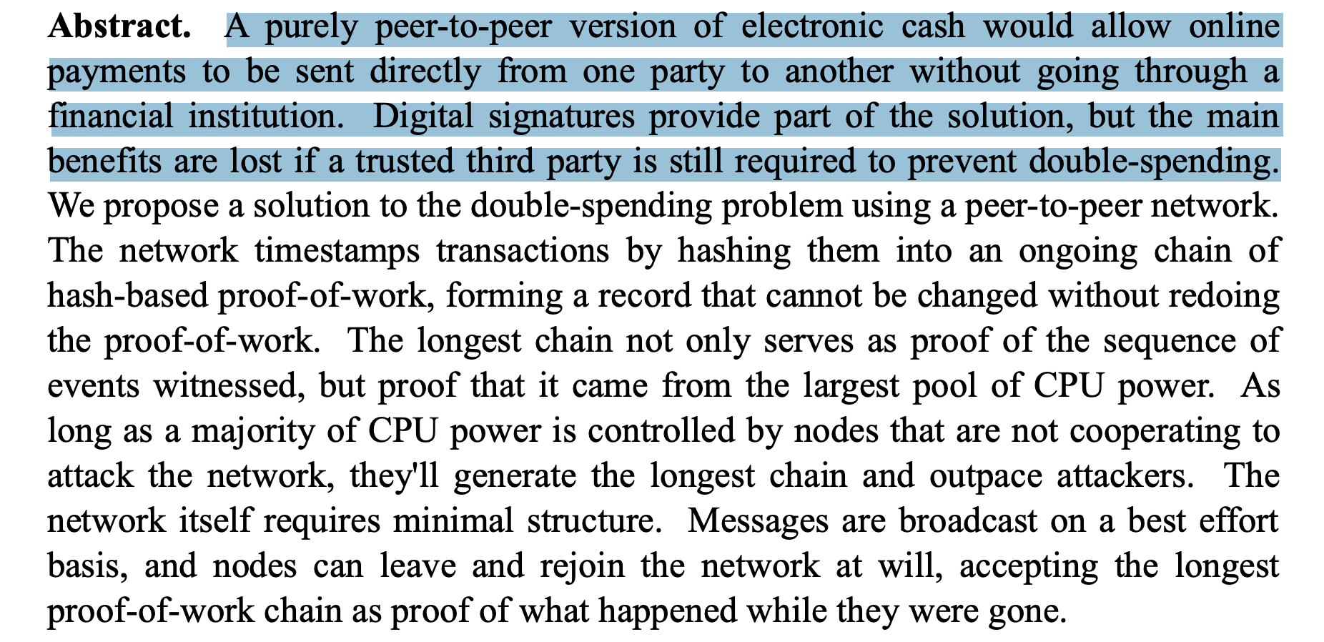
Bitcoin: Designed to be decentralized
Notes:
).

Slide 7
How To Decentralize ?
Satoshi Nakamoto addressed the following questions:
Who maintains the ledger of transactions ?
Who creates new bitcoins ?
Who determines how the rules of the system can changes?
How to determine what the value or a particular bitcoin is ?

Slide 8
How much is Bitcoin decentralized ?
Right now, there are different levels of centralization:
Very decentralized: Bitcoin network itself (easy to spin up a fully validating node)
Somewhat Centralized: Mining , it is open to anyone but too hard to do it in profitably way.
Very centralized in practice: Updating protocols and rules => updates on Bitcoin Core

Slide 9
Distributed Consensus
How can a group of users come to a consensus on the "true" state of something?
Distributed consensus protocol: in practice we have three kind of nodes (honest, faulty and malicious)
=> A Distributed consensus protocol has the following properties:
It must terminate with all honest nodes in agreement on the value.
The value must have been generated by an honest node.

Slide 10
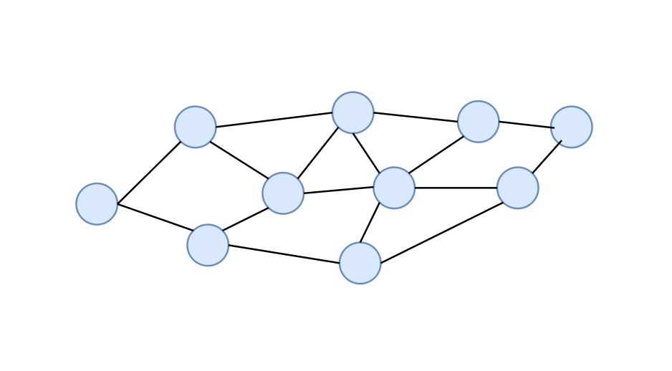
Transaction in Bitcoin
msg= "Pay Pk_{Sarah} 1 bitcoin"
sig = sign (msg, Sk_{Mehdi})
transmit(msg, sig)
Mehdi: " I want to send 1 bitcoin to Sarah "
Bitcoin
Network

Slide 11
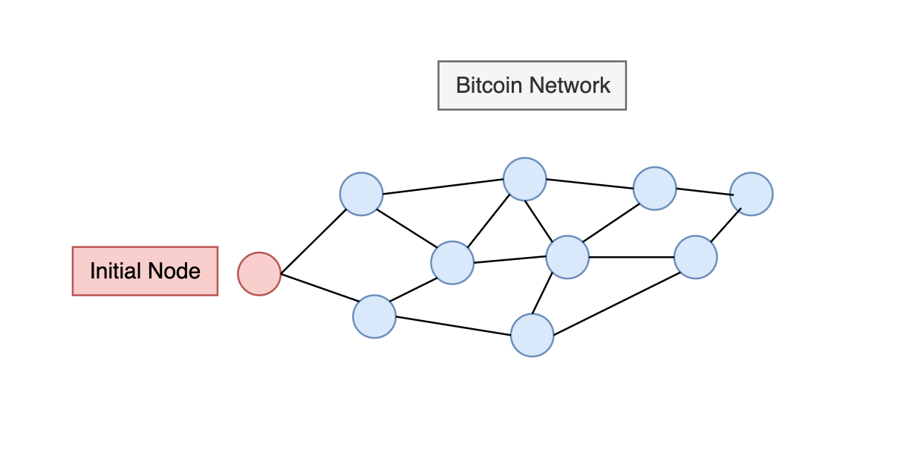
Possible Consensus Mechanism
Every node has:
The Blockchain up to that point in time.
A list of outstanding transactions which have been broadcast but are not yet in the blockchain (mempool)

Slide 12
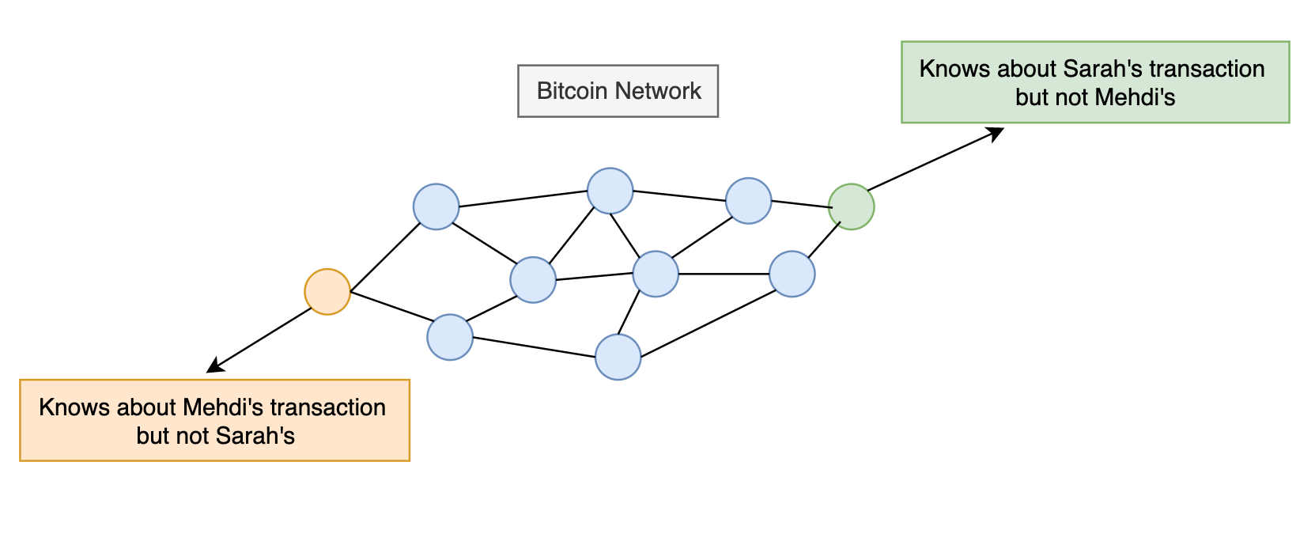
Possible Consensus Mechanism
Different nodes may have different transactions list.
Each 10 minutes, nodes uses some consensus mechanism (like voting) to determine which transactions to put in blockchain.
=> if a transaction is missed, no problem, wait for the next block

Slide 13
Problems with naïve Consensus Protocol
No notion of universal time (who decides when it has been 10 minutes ?)
Network is imperfect – some nodes will have high latency, faults in network, how many nodes actually exists ?
Malicious users could provide invalid/spam transactions?

Slide 14
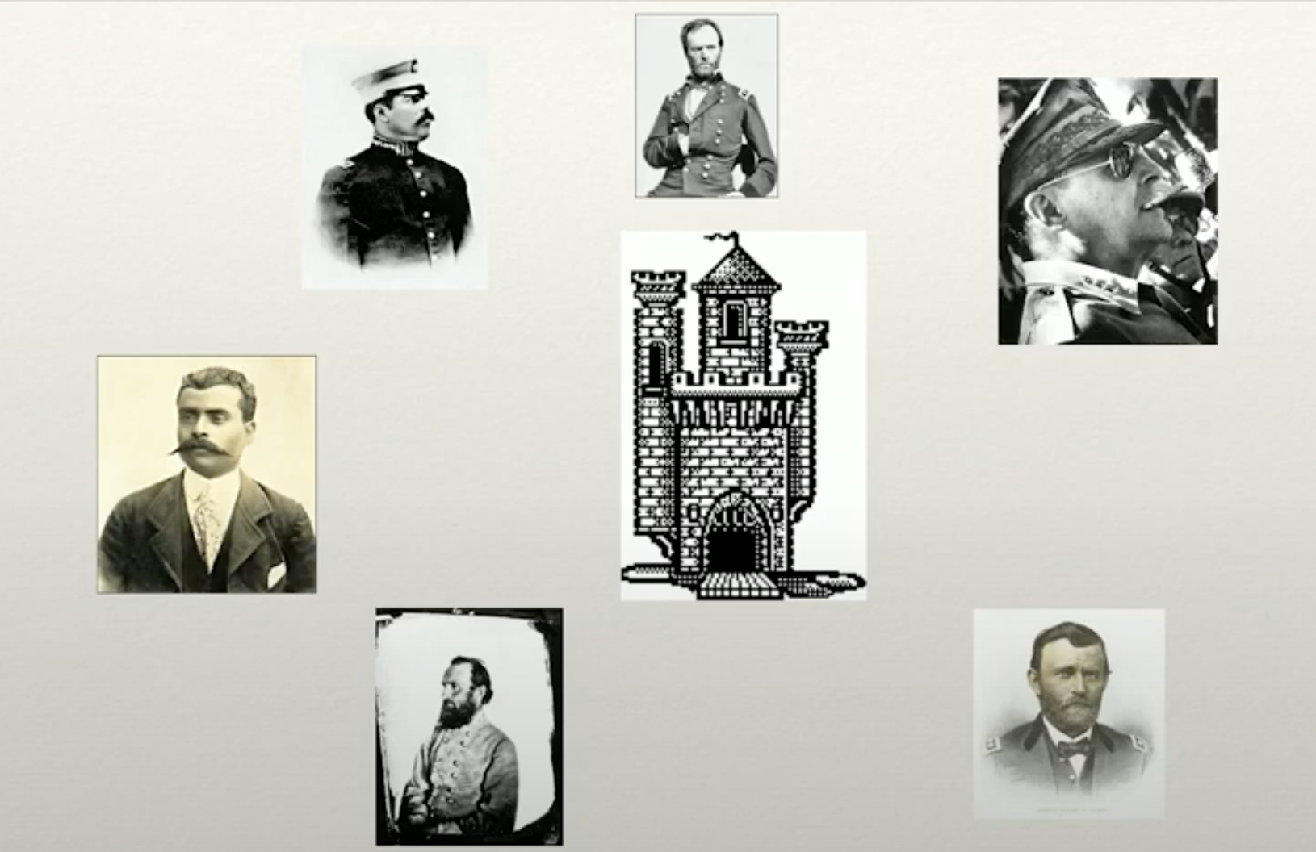
Byzantine Generals problem
Notes:
https://www.youtube.com/watch?v=nS9LH5gu65Y&ab_channel=Bittrio

Slide 15
Distributed Systems and Time
Segal's law: " A man with a watch knows what time it is. A man with two choices is never sure."
Lack of centralized mechanism of time control means that even-ordering is not strictly possible.
Many commons algorithms will not work when you don't/can't a concept of " do this, then that"

Slide 16
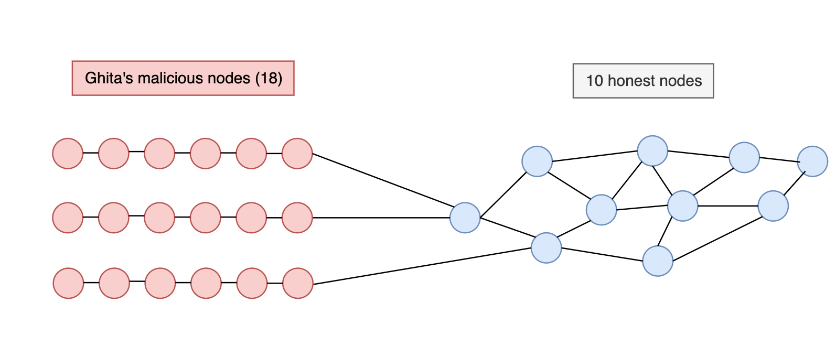
Sybil Attacks

Slide 17
Simplified Bitcoin Consensus Algorithm
New Transactions broadcast to all Nodes.
Each node collects new transactions into a block
In each round, a random node gets to broadcast its block (assuming we can avoid sybil attacks here)
Other nodes accept block if all transactions are valid.
Nodes express acceptance by including its hash in next block => lengthening the chain

Slide 18
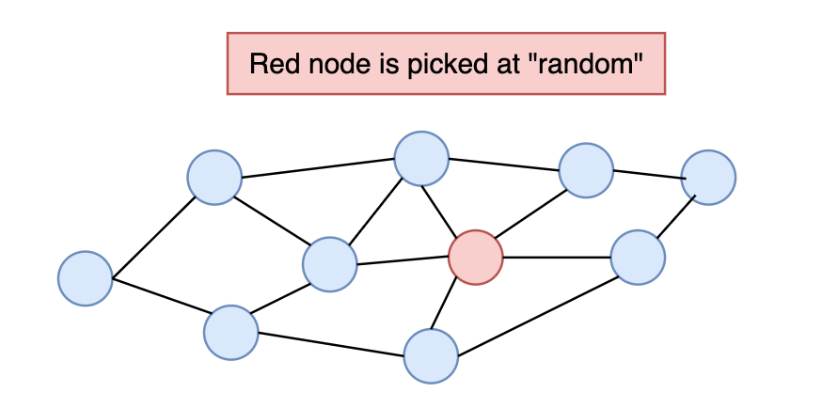
Simplified Consensus in Action
Recall all nodes have a copy of blockchain
Red Node packages all valid transactions into a block
Red Node broadcast new block
Other nodes add Red's new Block into their blockchain

Slide 19
Denial of Service
Red Node can package all transactions except Mehdi's into a block
=> Mehdi will not be able to perform a transaction

Slide 20
Double spend and Simplified Consensus 1/4
Mehdi purchases a software from Sarah for one Bitcoin and generates a transaction to that effect.
An honest node includes it in the Blockchain
Sarah sees that it has been confirmed, Mehdi receives the software.
Mehdi Node is selected for next block
Instead of building on block n, he builds on block n-1, ignoring the previous block and making his own block n where he gives his 1 bitcoin to another address that he controls
The block where Sarah receives 1 Bitcoin is useless => she didn't get paid

Slide 21
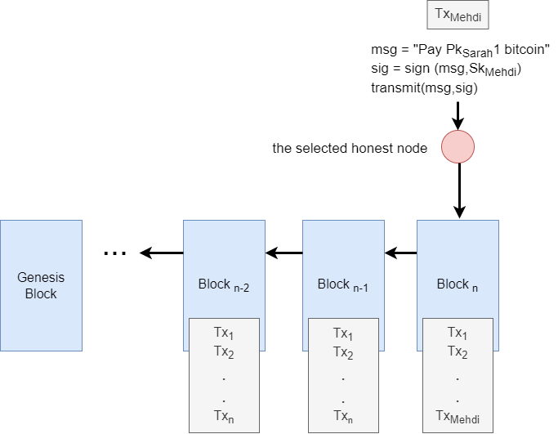
Double spend 2/4

Slide 22
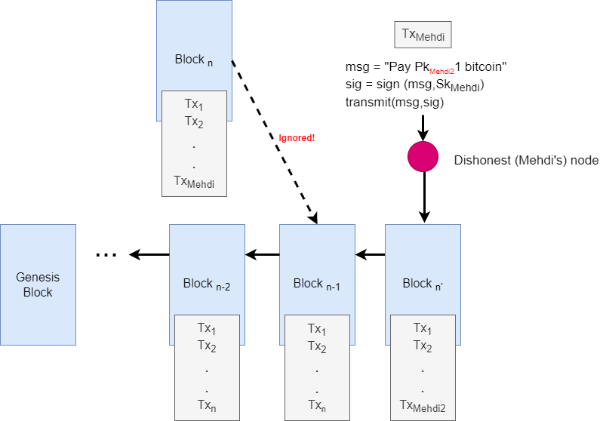
Double spend 3/4

Slide 23
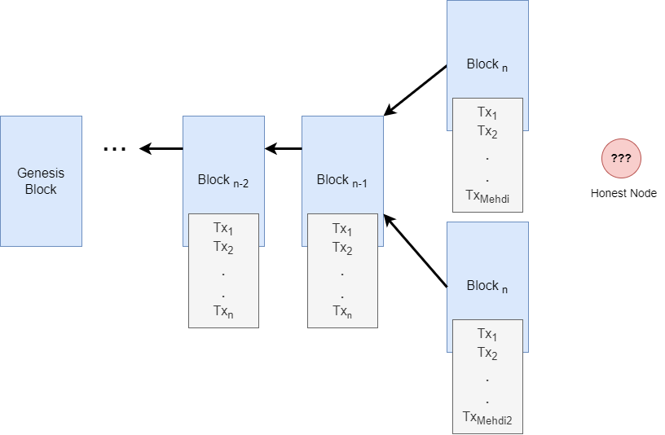
Double spend 4/4

Slide 24
Protecting against double spend
More blocks in blockchain since transaction, harder for someone to generate a different blockchain with different blocks
General rule in Bitcoin: wait 6 blocks for confirmation

Slide 25
What about sybil Attacks ?
Two related assumptions: > 50% of nodes are honest, plus invulnerable to sybil attacks.
Not true in practice... So how to avoid ?

